Slide 1
Spring Training

Slide 2
Day - 1

Slide 3
Introduction to Spring framework & Spring Modules

Slide 4
What is spring framework
The most popular application development for java.
Simpler and lightweight, easier to develop than JakartaEE
Provides a large number of helper classes to make things easier

Slide 5
What is in the latest version of the spring
Latest version is spring 5
Updated minimum requirement to Java 8.0 or higher
Deprecated legacy integration for Tiles, Velocity, portlets, Guava etc.
Upgraded Spring MVC to new version of Servlet API 4.0
Added new reactive programming framework: Spring WebFlux

Slide 6
Goals of Spring
Lightweight development with JAVA POJOs (Plain Old Java Objects)
Dependency injection to promote loose coupling
Declarative programming with Aspect-Oriented-Programing (AOP)
Minimize boilerplate java code
Promote good software development practice.

Slide 7
Spring modularity
Since its foundation, the framework has had a particular focus on modularity.
It is an important framework characteristic because it makes the framework an excellent option for different architectural styles and different parts of applications.
We can use the framework as we need and integrate it with a wide range of specification and third-party libraries.
It is divided into various modules. The main modules are as follows: 1. Spring Core 2. Spring Data 3. Spring Security 4. Spring Cloud 5. Spring Web-MVC

Slide 8
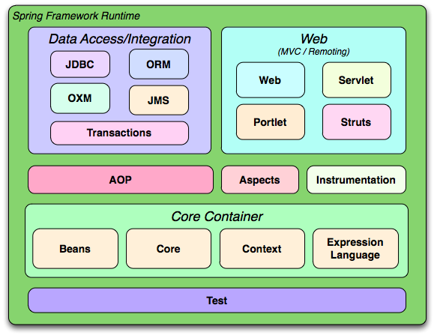

Slide 9
Project setup
Software requirements:
JDK (Java Development Kit)
Apache Tomcat Server (https://tomcat.apache.org/download-90.cgi)
Eclipse Or Intellij, IDE for JAVA EE developer (https://www.eclipse.org/downloads/packages/release/2020-12/r/eclipse-ide-enterprise-java-developers)
Note: We will use Maven project to download the required library/dependencies (i.e. avoid adding the dependent jar/s manually)
Project Setup With XML Based configurations:
Demo Hello-world Spring Applications
XML based for learning purpose only, preferred is java based and next session onwards, will use Java annotations based only

Slide 10
Day - 2

Slide 11
Spring Container
Create and manage the objects (Inversion of control)
Inject object’s dependencies (Dependency Injection)

Slide 12
Introduction to Java based annotations
Project Setup:
Auto wiring with Java annotations based configurations
Hello world Spring Application with Java based configurations
Going forward, will use Java based annotations

Slide 13
Day - 3

Slide 14
Introduction to Spring Bean
Bean Life Cycle
Bean Scopes

Slide 15
What is spring bean
A spring bean is simply a Java object.
When Java objects are created by the Spring Container, then Spring refers to them as "Spring Beans".
Spring Beans are created from normal Java classes .... just like Java objects.
In summary, whenever you see "Spring Bean", just think Java object.
Below is the definition from spring documentation In Spring, the objects that form the backbone of your application and that are managed by the Spring IoC container are called beans. A bean is an object that is instantiated, assembled, and managed by a Spring IoC container. Otherwise, a bean is simply one of many objects in your application. Beans, and the dependencies among them, are reflected in the configuration metadata used by a container.

Slide 16
In Spring, the objects that form the backbone of your application and that are managed by the Spring IoC container are called beans. A bean is an object that is instantiated, assembled, and otherwise managed by a Spring IoC container.
Simply put, Inversion of Control (IoC) is a process in which an object defines its dependencies without creating them. This object delegates the job of constructing such dependencies to an IoC container.
A Spring Bean represents a POJO component performing some useful operation. All Spring Beans reside within a Spring Container also known as IOC Container.
The Spring Framework is transparent and thereby hides most of the complex infrastructure and the communication that happens between the Spring Container and the Spring Beans.

Slide 17
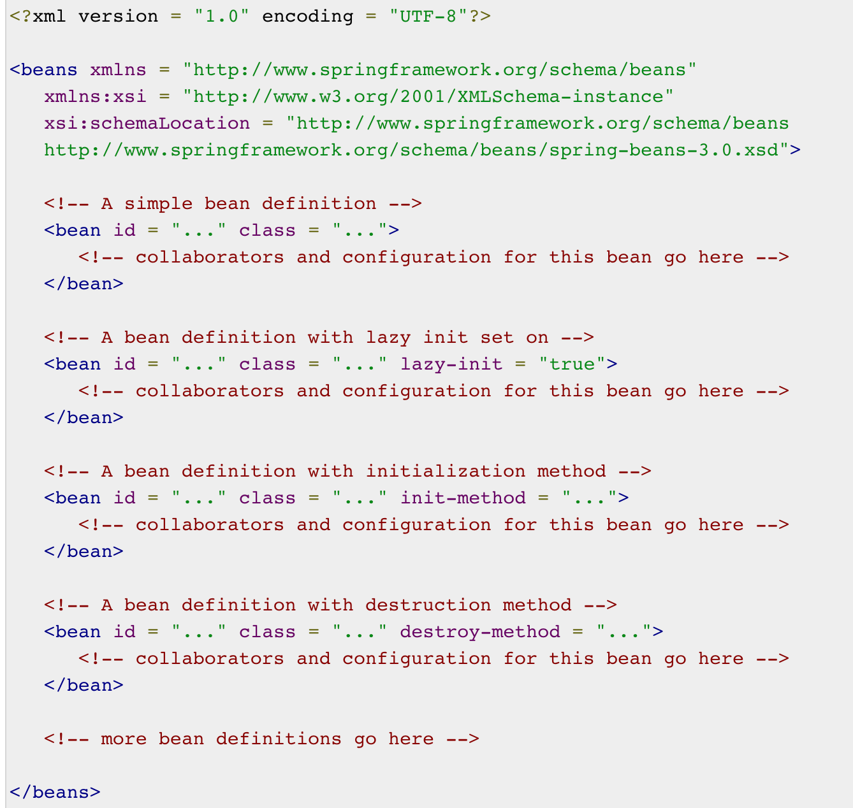
Bean Definition

Slide 18
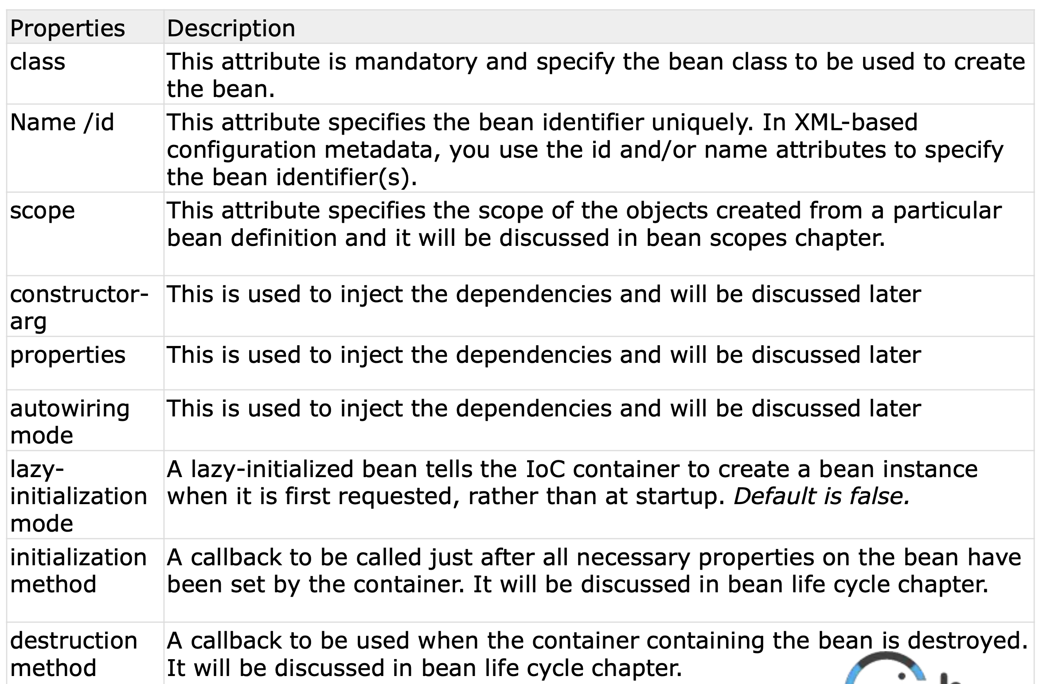
Bean Properties

Slide 19
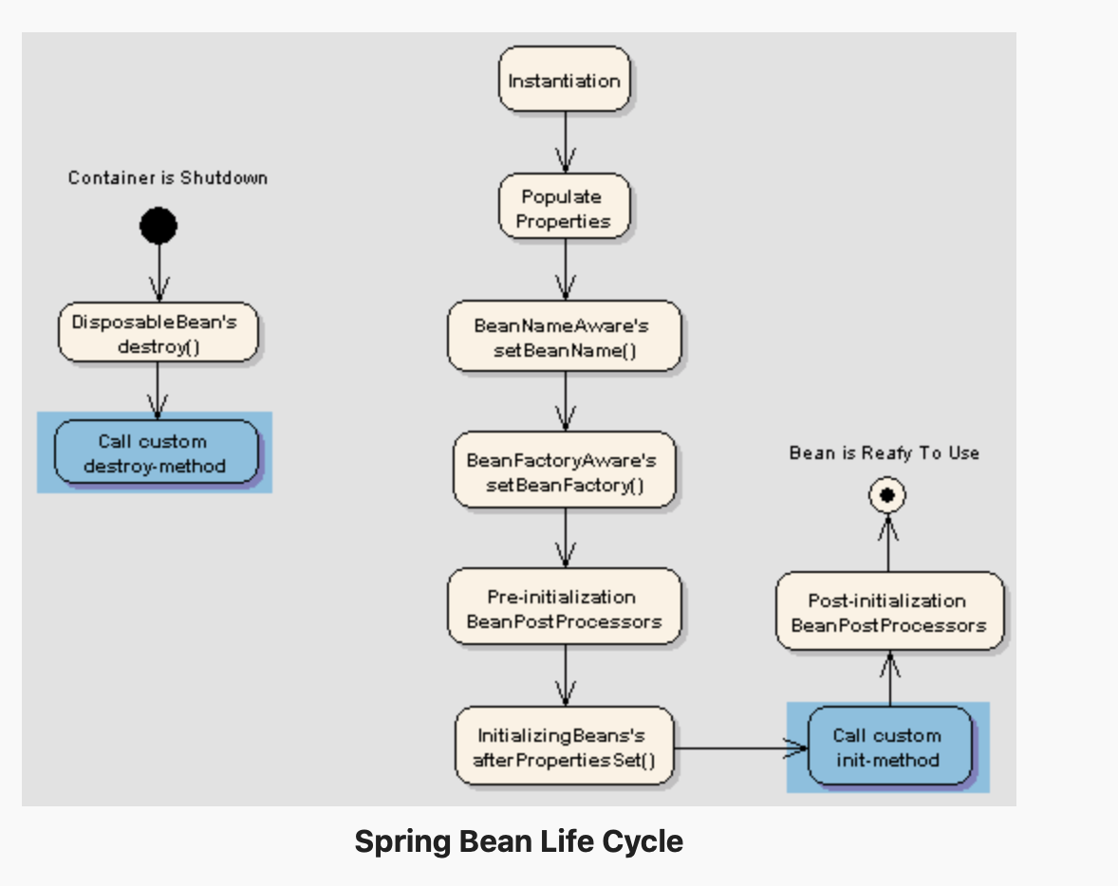
Bean Life Cycle

Slide 20
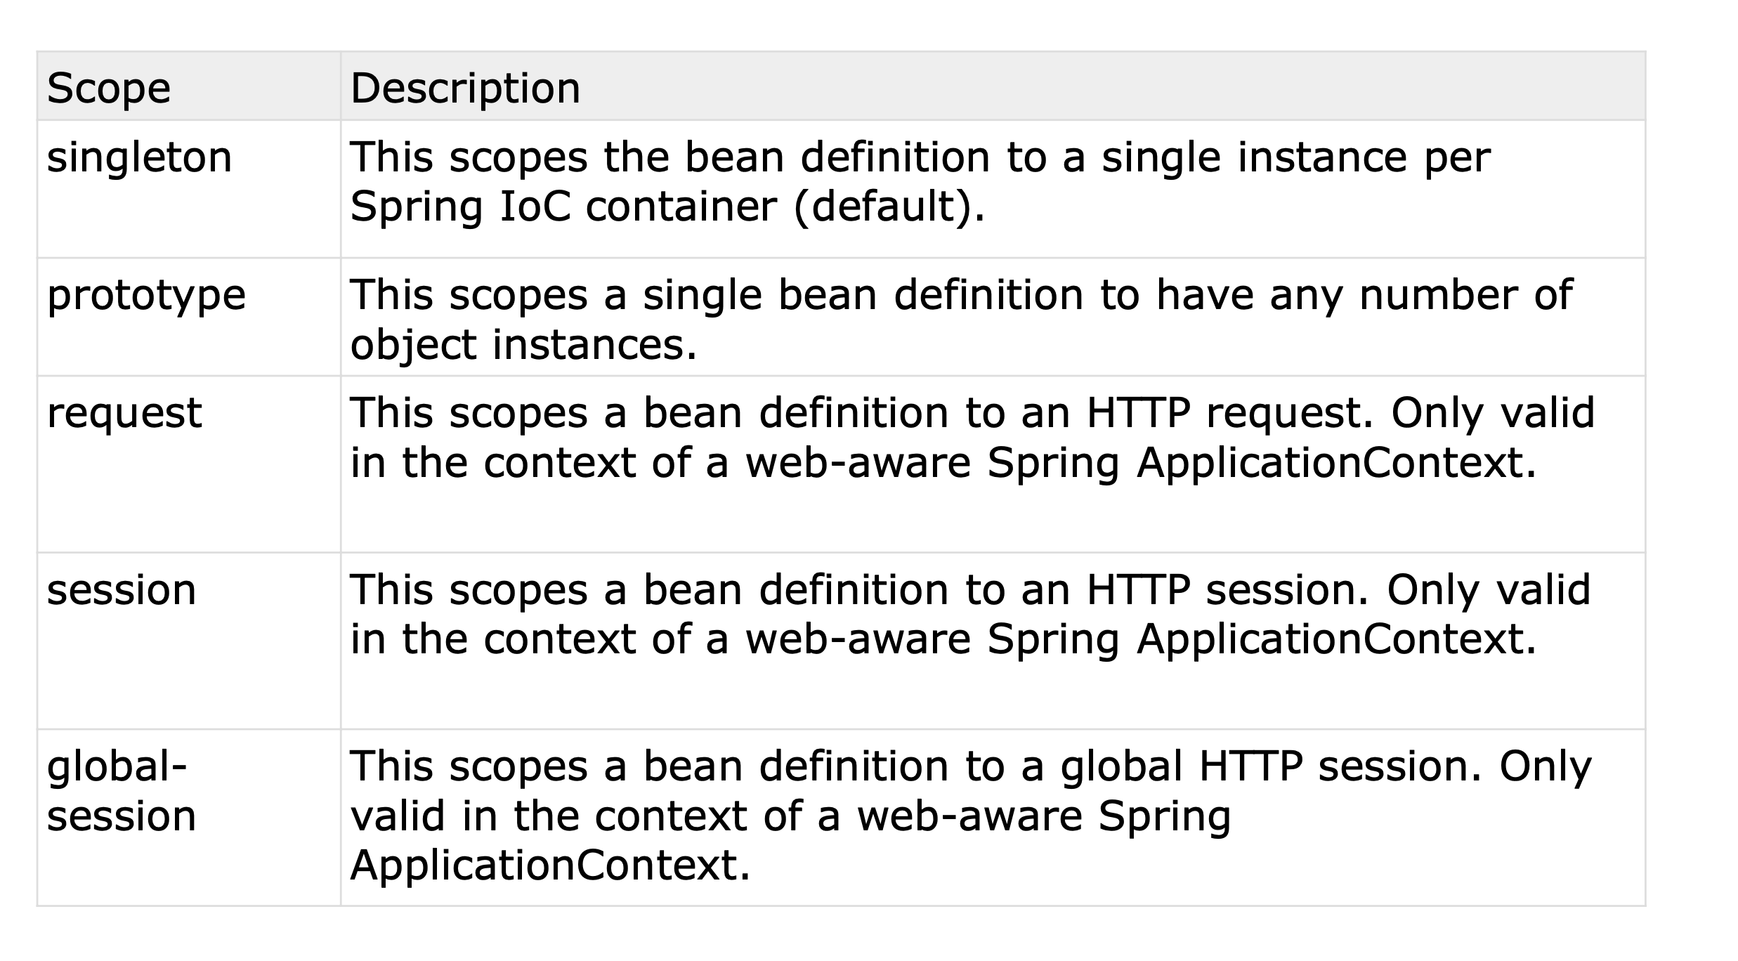
Bean
Scope

Slide 21
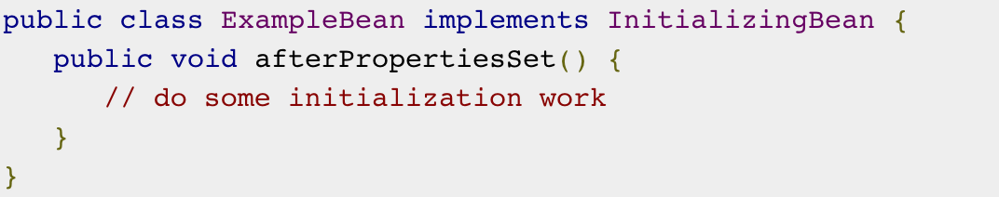
Initialization Callbacks
<bean id = "exampleBean" class = "examples.ExampleBean" init-method = "init"/>

Slide 22
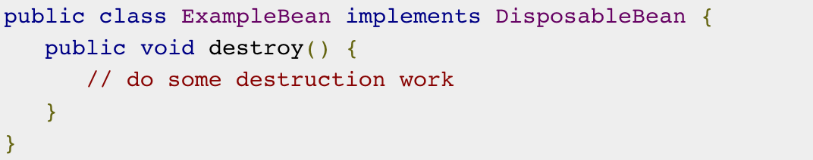
Destruction Callbacks
<bean id = "exampleBean" class = "examples.ExampleBean" destroy-method = "destroy"/>

Slide 23
Reference
https://www.tutorialspoint.com/spring/spring_bean_scopes.htm
https://www.tutorialspoint.com/spring/spring_bean_life_cycle.htm
https://examples.javacodegeeks.com/spring-bean-life-cycle-exampl
https://www.tutorialspoint.com/spring/spring_bean_definition_inheritance.htm
https://www.tutorialspoint.com/spring/spring_injecting_inner_beans.htm
https://www.tutorialspoint.com/spring/spring_injecting_collection.htm

Slide 24
Day - 4

Slide 25
Understanding Spring Web MVC
This module is the first one built by the Spring Team to support the web applications in Spring Framework.
This module uses the Servlet API as its foundation so these web applications must follow the Servlet Specification and be deployed into servlet containers.
The Spring Web MVC module was developed using the front controller pattern. Under the hood, there is the main servlet in Spring called DispatcherServlet. This servlet will redirect through an algorithm to do the desired work.
It enables developers to create amazing web applications on the Java platform.
Also, the framework allows developers to build REST APIs with this module.

Slide 26
Spring Web MVC Project Set-up
Demo
Set-up: IDE, Maven project, Tomcat server
Spring web application - Hello World

Slide 27
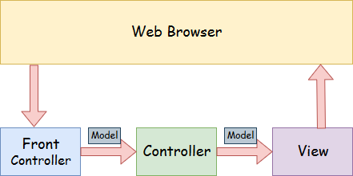

Slide 28
Day - 5

Slide 29
Spring Web MVC
Spring MVC with various HTTP request/responses:
Basic HTTP concepts: e.g. GET v/s POST, Status codes e.g. 200/3xx/4xx/5xx
Request/response
Path/query parameters, payload
Request/response HEADER

Slide 30
Spring Boot Training

Slide 31
Day - 6

Slide 32
Introduction to Spring Boot
Spring boot architecture, dispatcher servlet
Setup spring boot Web project
Spring boot Web, demo restful service using spring boot starters

Slide 33
Why Spring boot?
Developer
Spring boot
Spring

Slide 34
Key points
Starter Dependencies
Embedded Server
Metrics and health check
Automatic configuration

Slide 35
Architecture of Spring boot
Presentation Layer
Business Layer
Persistence Layer
Database Layer

Slide 36
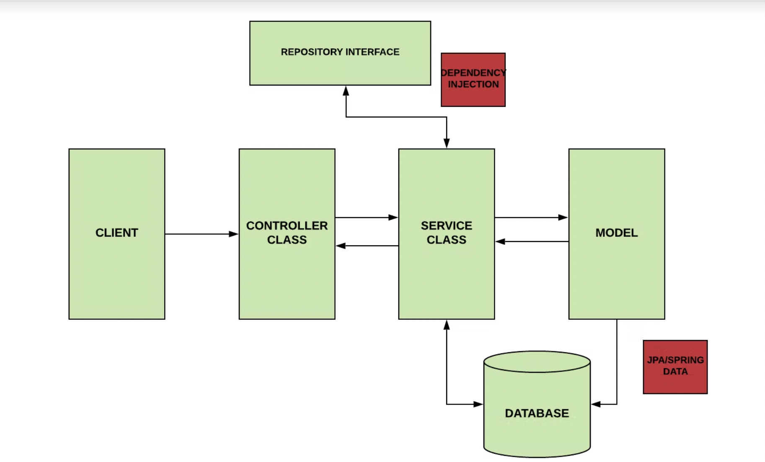
Workflow of Spring boot

Slide 37
Dispatcher Servlet
Main/Front Controller
chatgpt.com/new
chatgpt.com/ai
Front Controller
chatgpt.com
Client
chatgpt.com/ai

Slide 38
Hands-On
Create a spring boot project, in which user will send json file and in response, the content of the file must be received.
Create a spring boot project, in which user will send image and in response, the image must be received.

Slide 39
Day - 7

Slide 40
Spring Boot
CRUD Operations using persistence layer (demo using in memory/H2 database)
JSON payload/response

Slide 41
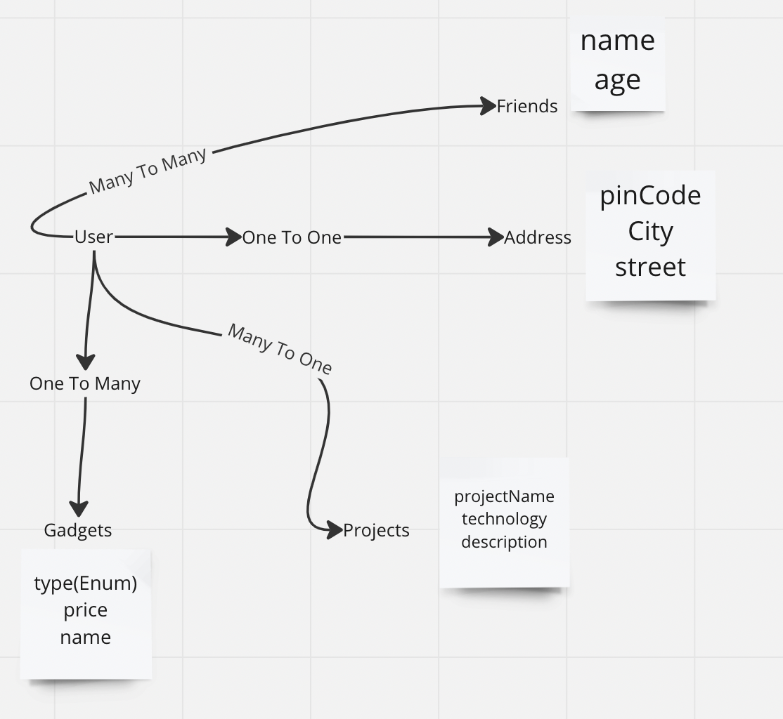
Hands-on
Create CRUD operation for User and create database schema

Slide 42
Day - 8

Slide 43
Spring Boot
Pagination overview
GET all/listing operations with server side pagination/sorting/filtering

Slide 44
Day - 9

Slide 45
Understanding AOP
Spring Boot Understanding AOP Concepts and Terminology
AOP demo

Slide 46
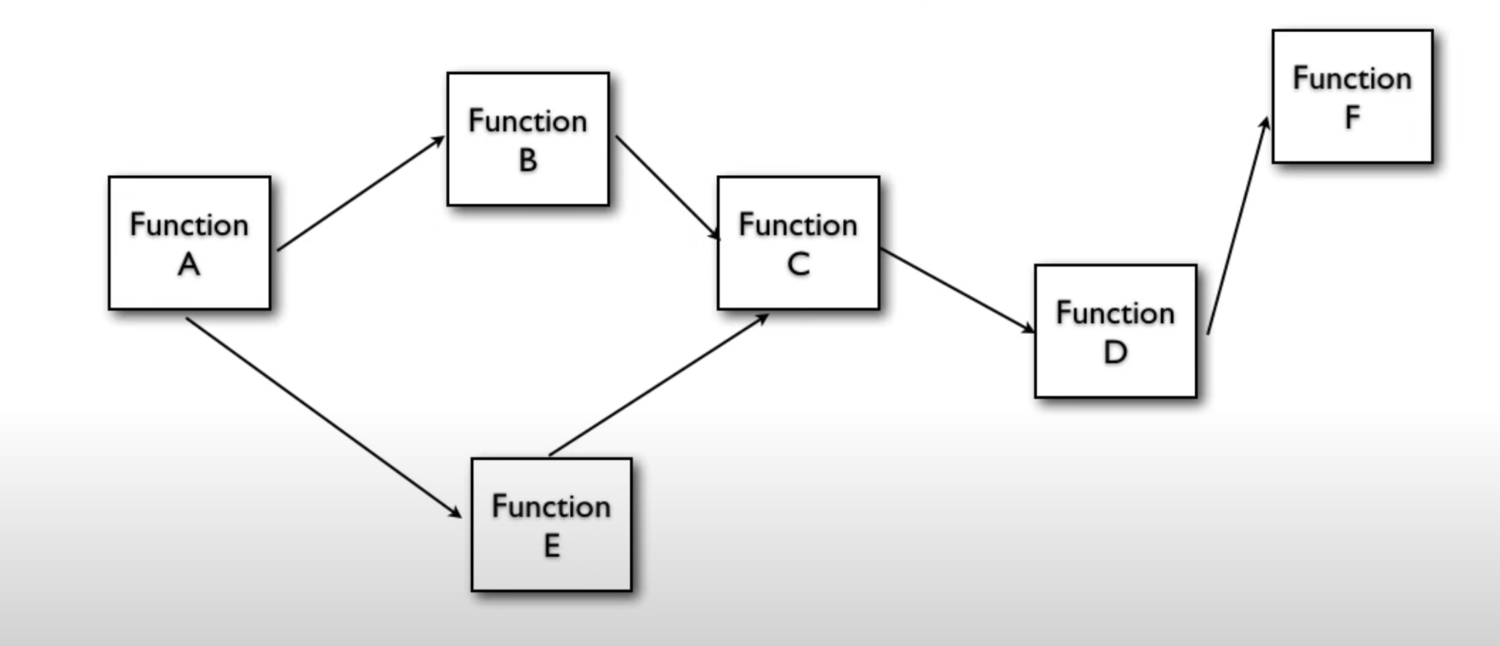
Functional Programming

Slide 47
Object Oriented Programming
Object A
Variables
Methods
Object B
Variables
Methods
Object C
Variables
Methods

Slide 48
Common Functionality
Object A
Variables
Methods
log()
Object B
Variables
Methods
log()
Object C
Variables
Methods
log()

Slide 49
Possible Solution
Object A
Variables
Methods
Logger.log()
Object B
Variables
Methods
Logger.log()
Object C
Variables
Methods
Logger.log()
Logger
log()

Slide 50
Problems
Too many relationships to the Crosscutting objects
Code is required
Cannot be changed all at once

Slide 51
Other concerns
Logging
Transactions
Security
Caching
Monitoring

Slide 52
AOP
Object A
Variables
Methods
Object B
Variables
Methods
Object C
Variables
Methods
Logger Aspect

Slide 53
Hands-On
Print log message with classname, methodname, arguments before method call and after method call
Print log message for specific class and specific method

Slide 54
Day - 10

Slide 55
Exception Handling
Implementing Exception Handling

Slide 56
Day - 11

Slide 57
Externalized Configs
Profiles
Externalized configurations

Slide 58
Profiles and Externalized Configuration
Develop
Developers
ChatGpt
Prod
Test

Slide 59
Day - 12

Slide 60
Testing
Testing in Spring boot
Two type of testing
Unit testing
Use to test methods
Integration testing
Use to test controller/APIs
Testing is used to test application for expected behaviour
Multiple libraries available for testing like,
Junit
AssertJ

Slide 61
Annotations for test cases
@springboottest
@test
@mock
@beforeEach
@beforeAll
@AfterEach
@AfterAll

Slide 62
Methods for assertion
assertEquals
assertThrows
assertFalse
assertDoesNotThrows
and many more…

Slide 63
MockMvc
Used to perform API testing
ex.
mockMvc.perform(MockMvcRequestBuilders.post("/api/v1/user”)
.header("authorization", bearToken)
.contentType(MediaType.APPLICATION_JSON)
.content(content)
)
.andExpect(status().isCreated())
.andExpect(MockMvcResultMatchers.jsonPath("$.name").value("name"))
.andExpect(MockMvcResultMatchers.jsonPath("$.alias").value("alias"));

Slide 64
Hands-On
Write Unit test and Integration test, positive and negative scenario test cases for User model we have used in Day-7 training

Slide 65
Spring Boot
Event Listeners

Slide 66
Events

Slide 67
Exchange of information
Method
calls
Events

Slide 68
What is event?
An event, in a computing context, is an action or occurrence that can be identified by a program and has significance for software.

Slide 69
Types of Events
Application Events
User actions
Logging in
Application Configuration
System Events
System environment
Hardware
System clock
System memory

Slide 70
Steps for creating event
Data source
Publisher
Listener

Slide 71
Hands-On
Create a ecommerce application and create a service to add product in the cart and make that code asynchronous using events.

Slide 72
From here…
Self study, explore more:
Spring Boot File-upload
Spring Boot Logging
View Templates (e.g. Thymeleaf)
Spring Boot JPA, Spring Boot JDBC
Spring Boot Interceptor, Servlet Filters
Spring Boot Internationalization
Spring Boot Runners
Spring Boot Authorization, Authentication, OAuth2 with JWT
Spring Boot Scheduling
Spring Boot Flyway Database
Spring Boot Rest Template
Spring Boot Swagger Documentation
Spring Boot Actuator, Spring Cloud,
Basic Docker concepts

